Slide 1

BLUEBIKE DEPLOYMENT
Presented By: Jinqiao Chen, Ming Luo
Northeastern University | 2024

Slide 2
1
OVERVIEW
1 Problem Statement
4 Data Process
2 Data Collection
5 Model & Validation
3 Assumption
6 Conclusion
Northeastern University | 2024

Slide 3
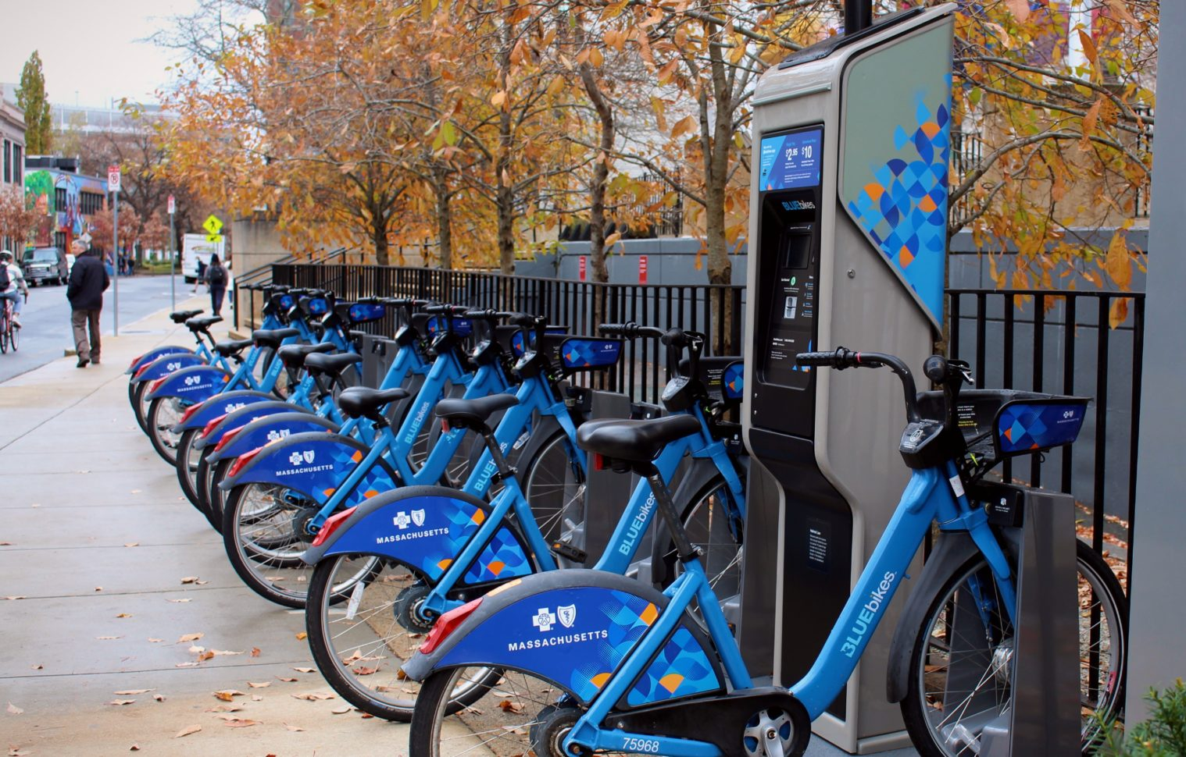
Problem
Statement
1
2
Data Collection
2
Background
Assumption
3
Bluebike is Metro Boston’s public bike share program, with over 4,000+ bikes and more than 400+ stations across various towns such as Boston and Cambridge.
4
Data
Process
Goal
5
Analyze two of the most popular stations in two different regions and provide advice to optimize the usage of those stations and increase the potential revenue.
Model &
Validation
6
Conclusion
Northeastern University | 2024
Data Source
The comprehensive trip histories dataset that published by Bluebike official website.
The dataset includes:
Trip Duration (seconds)
Start Time and Date
End Time and Date
Start Station Name & ID
End Station Name & ID

Slide 4
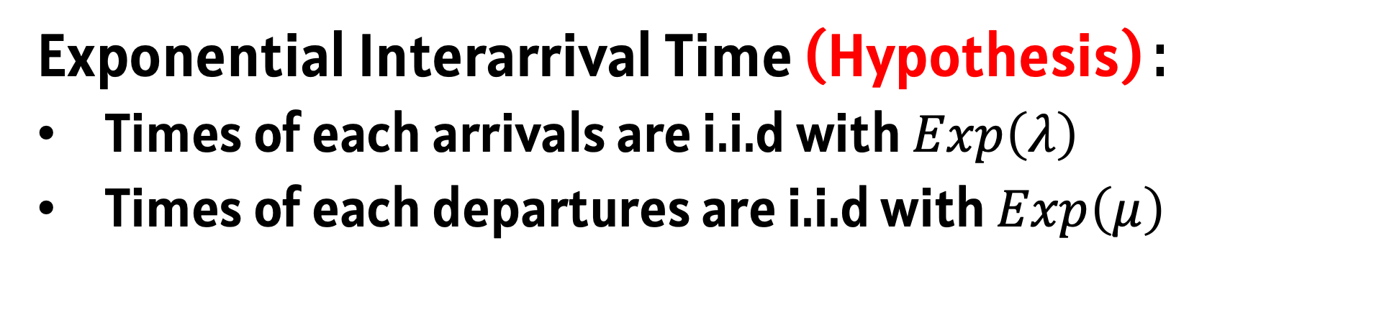
Background
Bluebike is Metro Boston’s public bike share program, with over 4,000+ bikes and more than 400+ stations across various towns such as Boston and Cambridge.
Goal
Analyze two of the most popular stations in two different regions and provide advice to optimize the usage of those stations and increase the potential revenue.
Problem
Statement
1
3
Data Source
Data Collection
2
The comprehensive trip histories dataset that published by Bluebike official website.
The dataset includes:
Trip Duration (seconds)
Start Time and Date
End Time and Date
Start Station Name & ID
End Station Name & ID
Assumption
3
4
Data
Process
5
Model &
Validation
6
Conclusion
Northeastern University | 2024
B-D Process with Capacity N
1
Continuous – Time Markov Chain:
State : # of available bikes in a dock station (Discrete)
Time of transition is continuous and independent of previous transitions
2
Consecutive Transition:
# of bikes in the system can only increase or decrease one at one time
# of docks is limited at a dock station
3
Exponential Interarrival Time (Hypothesis) :
Times of each arrivals are i.i.d with $Exp\left(λ\right)$
Times of each departures are i.i.d with $Exp\left(μ\right)$

Slide 5
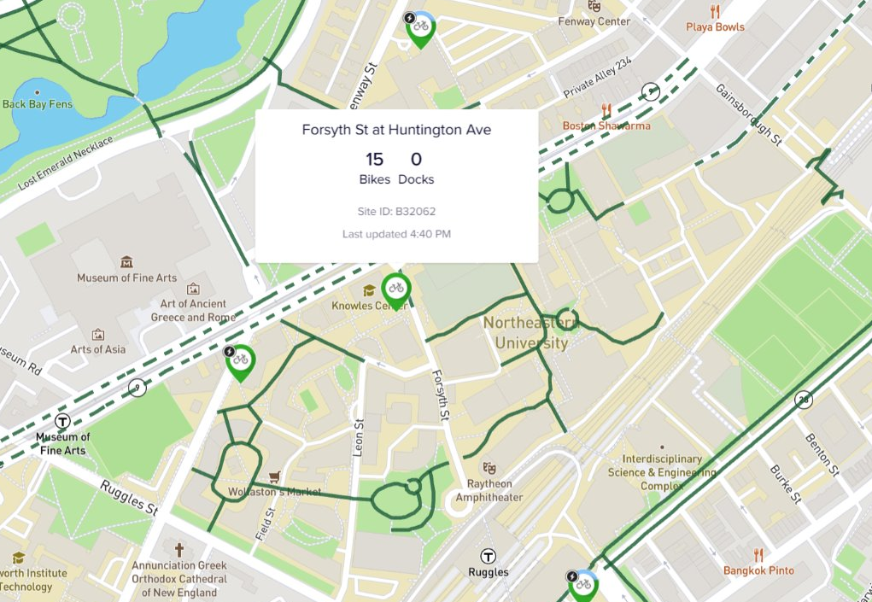
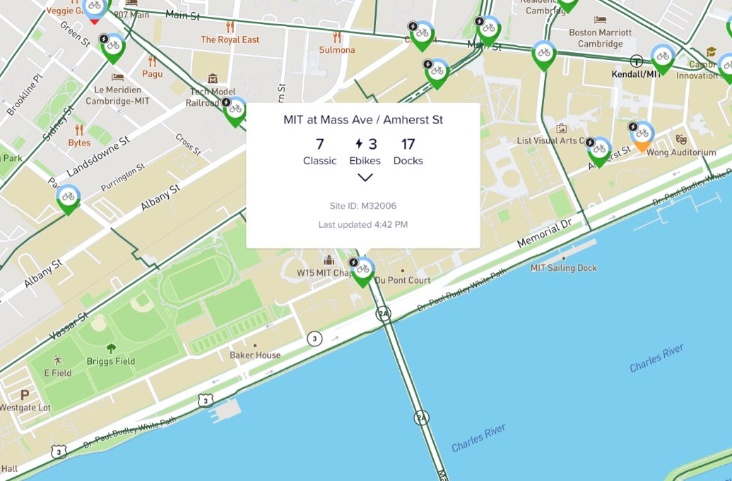
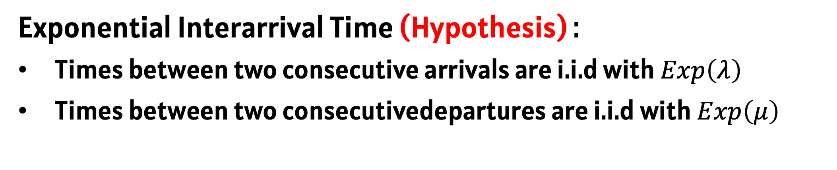
Data Source
The comprehensive trip histories dataset that published by Bluebike official website.
The dataset includes:
Trip Duration (seconds)
Start Time and Date
End Time and Date
Start Station Name & ID
End Station Name & ID
Problem
Statement
1
4
B-D Process with Capacity N
Data Collection
2
1
Continuous – Time Markov Chain:
State : # of available bikes in a dock station (Discrete)
Time of transition is continuous and independent of previous transitions
Assumption
3
2
Consecutive Transition:
# of bikes in the system can only increase or decrease one at one time
# of docks is limited at a dock station
4
Data
Process
5
Model &
Validation
3
Exponential Interarrival Time (Hypothesis) :
Times between two consecutive arrivals are i.i.d with $Exp\left(λ\right)$
Times between two consecutivedepartures are i.i.d with $Exp\left(μ\right)$
6
Conclusion
Northeastern University | 2024
1
We select the dataset of rush hours (4:30PM - 6:30PM) from 9/1/2023 - to 9/30/2023 (exclude weekend) at two stations. Both stations are among the top 10 busiest stations according to Bluebike’s annual report.
Forsyth St. at Huntington Ave
(NEU)
Mass Ave/Amherst Station
(MIT)

Slide 6
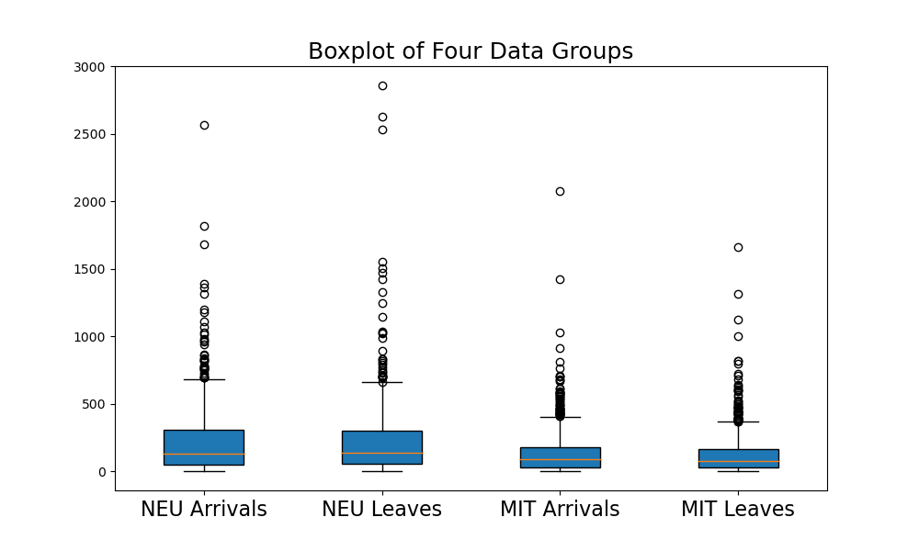
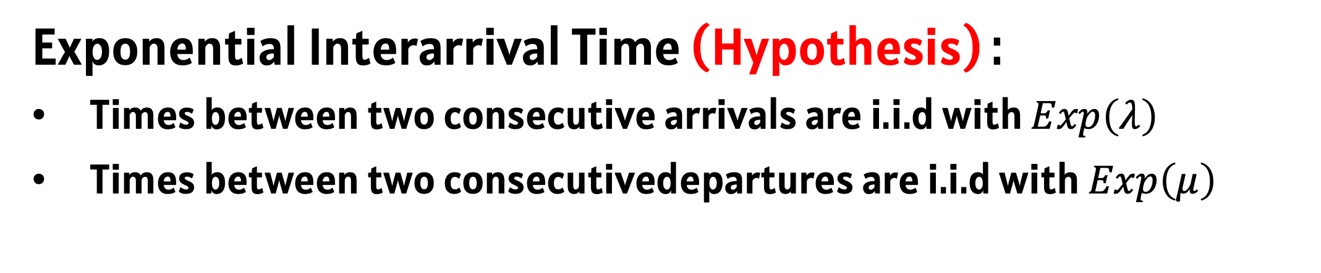
B-D Process with Capacity N
1
Continuous – Time Markov Chain:
State : # of available bikes in a dock station (Discrete)
Time of transition is continuous and independent of previous transitions
2
Consecutive Transition:
# of bikes in the system can only increase or decrease one at one time
# of docks is limited at a dock station
3
Exponential Interarrival Time (Hypothesis) :
Times between two consecutive arrivals are i.i.d with $Exp\left(λ\right)$
Times between two consecutivedepartures are i.i.d with $Exp\left(μ\right)$
Problem
Statement
1
5
1
We select the dataset of rush hours (4:30PM - 6:30PM) from 9/1/2023 - to 9/30/2023 (exclude weekend) at two stations. Both stations are among the top 10 busiest stations according to Bluebike’s annual report.
Data Collection
2
Assumption
3
4
Data
Process
5
Model &
Validation
6
Forsyth St. at Huntington Ave
(NEU)
Mass Ave/Amherst Station
(MIT)
Conclusion
Northeastern University | 2024
2
For each station, we developed two distinct datasets：
Birth Dataset: Time between consecutive bike arrivals
Death Dataset: Time between consecutive bike departures
3
By checking the boxplots, we found some outliers and removed them​

Slide 7
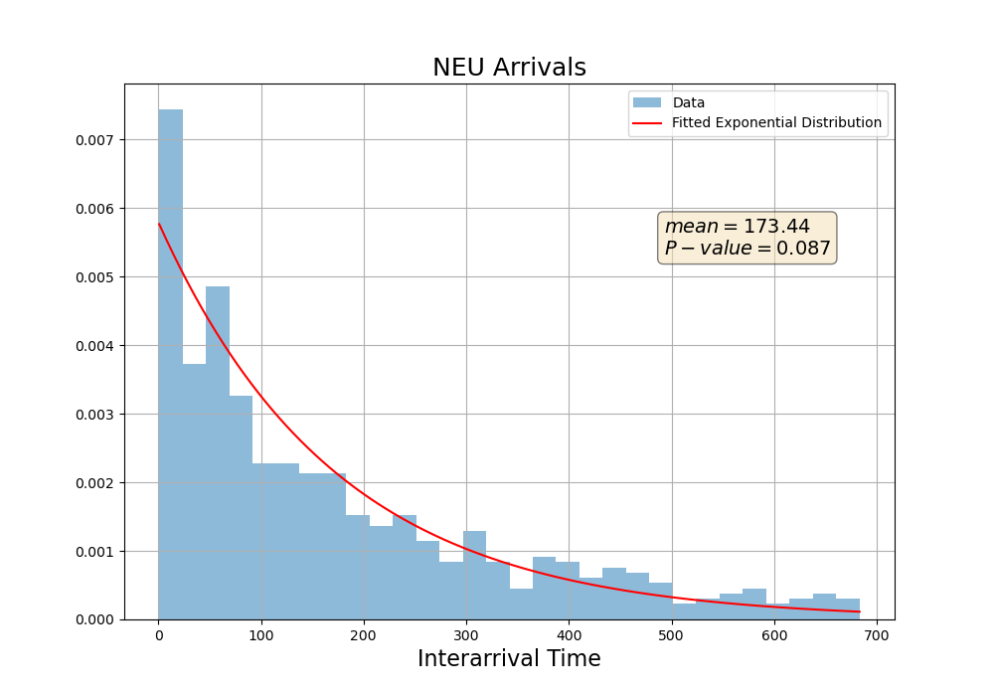
1
We select the dataset of rush hours (4:30PM - 6:30PM) from 9/1/2023 - to 9/30/2023 (exclude weekend) at two stations. Both stations are among the top 10 busiest stations according to Bluebike’s annual report.
Forsyth St. at Huntington Ave
(NEU)
Mass Ave/Amherst Station
(MIT)
Problem
Statement
1
6
2
For each station, we developed two distinct datasets：
Birth Dataset: Time between consecutive bike arrivals
Death Dataset: Time between consecutive bike departures
Data Collection
2
3
By checking the boxplots, we found some outliers and removed them​
Assumption
3
4
Data
Process
5
Model &
Validation
6
Conclusion
Northeastern University | 2024
1
Goodness of fit: K-S Test
 | Parameters
Neu Arrival | 1/173.44

Slide 8
2
For each station, we developed two distinct datasets：
Birth Dataset: Time between consecutive bike arrivals
Death Dataset: Time between consecutive bike departures
3
By checking the boxplots, we found some outliers and removed them​
Problem
Statement
1
7
1
Goodness of fit: K-S Test
Data Collection
2
 | Parameters
Neu Arrival | 1/173.44
Assumption
3
4
Data
Process
5
Model &
Validation
6
Conclusion
Northeastern University | 2024

Slide 9
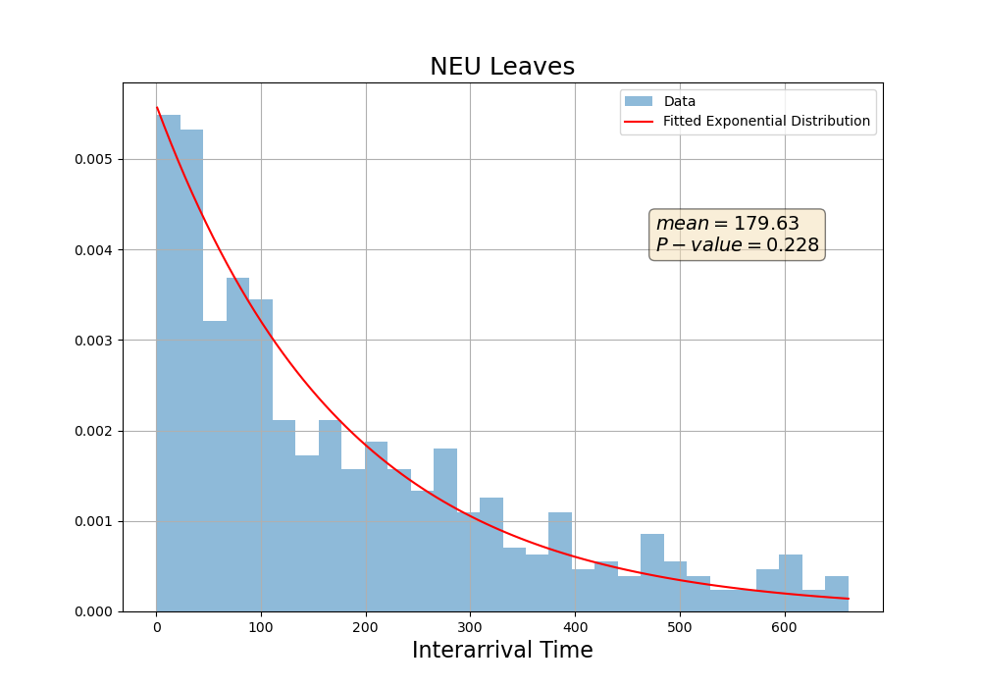
Problem
Statement
1
7
1
Goodness of fit: K-S Test
Data Collection
2
 | Parameters
Neu Arrival | 1/173.44
Neu Leaves | 1/179.63
Assumption
3
4
Data
Process
5
Model &
Validation
6
Conclusion
Northeastern University | 2024

Slide 10
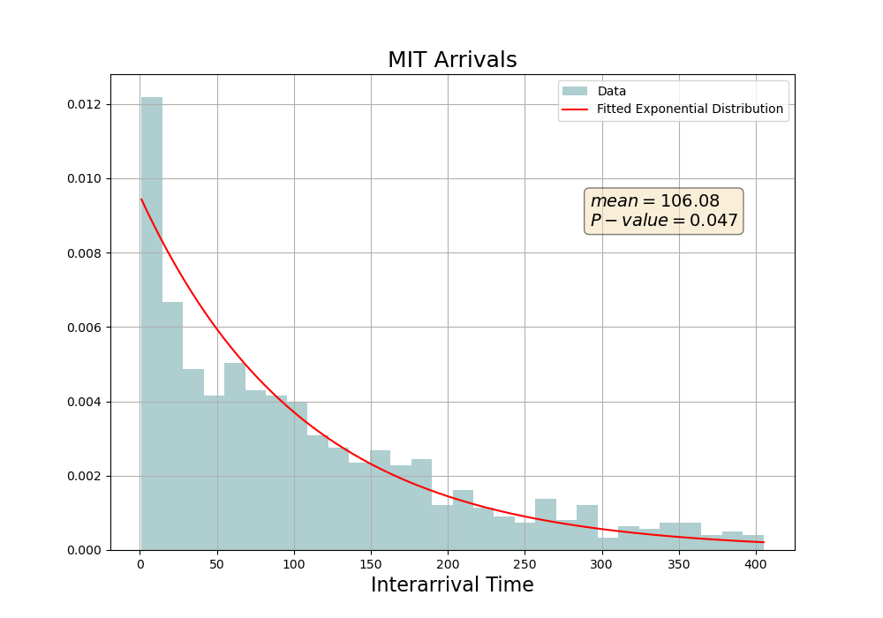
Problem
Statement
1
7
1
Goodness of fit: K-S Test
Data Collection
2
 | Parameters
Neu Arrival | 1/173.44
Neu Leaves | 1/179.63
MIT Arrivals | 1/106.08
Assumption
3
4
Data
Process
5
Model &
Validation
6
Conclusion
Northeastern University | 2024

Slide 11
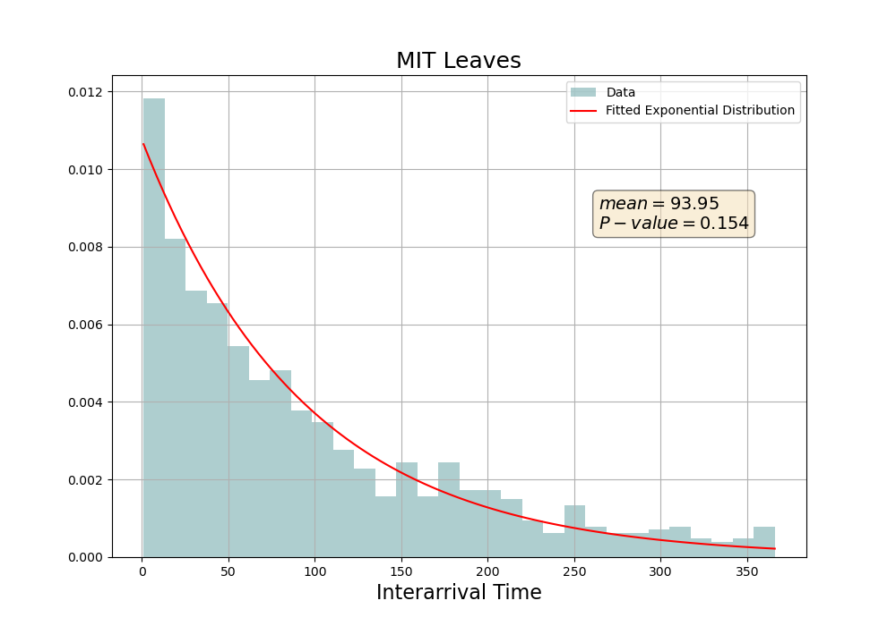

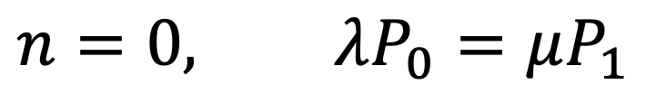


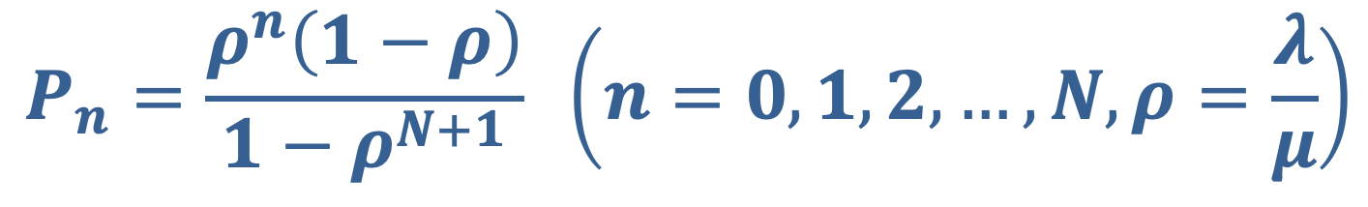



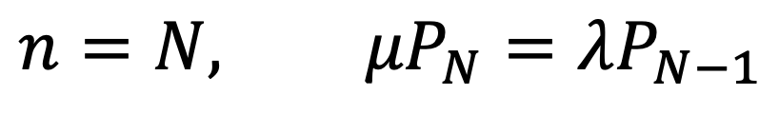


Problem
Statement
1
7
1
Goodness of fit: K-S Test
Data Collection
2
 | Parameters
Neu Arrival | 1/173.44
Neu Leaves | 1/179.63
MIT Arrivals | 1/106.08
MIT Leaves | 1/93.95
Assumption
3
4
Data
Process
5
Model &
Validation
6
Conclusion
Northeastern University | 2024
2
Algorithm
$$λ$$
$$λ$$
$$λ$$
$$λ$$
0
1
2
N
$$μ$$
$$μ$$
$$μ$$
$$μ$$
$$n=0, λP_{0}=μP_{1}$$
$$1≤n≤N−1, \left(λ+μ\right)P_{n}=λP_{n−1}+μP_{n+1}$$
$$n=N, {μP}_{N}=λP_{N−1}$$
$$P_{n}=\frac{ρ^{n}\left(1−ρ\right)}{1−ρ^{N+1}} \left(n=0, 1, 2, …, N, ρ=\frac{λ}{μ}\right)$$

Slide 12

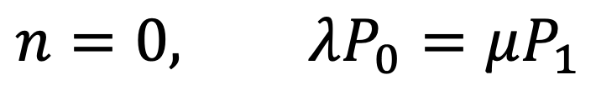

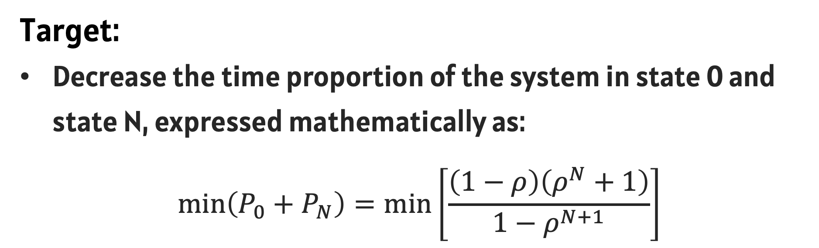




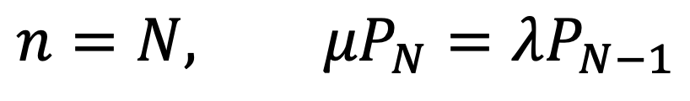



1
Goodness of fit: K-S Test
 | Parameters
Neu Arrival | 1/173.44
Neu Leaves | 1/179.63
MIT Arrivals | 1/106.08
MIT Leaves | 1/93.95
Problem
Statement
1
8
2
Algorithm
Data Collection
2
$$λ$$
$$λ$$
$$λ$$
$$λ$$
0
1
2
N
Assumption
3
$$μ$$
$$μ$$
$$μ$$
$$μ$$
4
Data
Process
$$n=0, λP_{0}=μP_{1}$$
5
$$1≤n≤N−1, \left(λ+μ\right)P_{n}=λP_{n−1}+μP_{n+1}$$
Model &
Validation
$$n=N, {μP}_{N}=λP_{N−1}$$
6
$$P_{n}=\frac{ρ^{n}\left(1−ρ\right)}{1−ρ^{N+1}} \left(n=0, 1, 2, …, N, ρ=\frac{λ}{μ}\right)$$
Conclusion
Northeastern University | 2024
3
Criteria
Two States of Interest:
State 0 : No available bike at a dock station, which means users cannot borrow bikes when they have demands
State N : All docks are occupied at a dock station, which means users are unable to return their bikes and end their trips.
Target:
Decrease the time proportion of the system in state 0 and state N, expressed mathematically as:
$$\min\left(P_{0}+P_{N}\right)=\min\left[\frac{\left(1−ρ\right)\left(ρ^{N}+1\right)}{1−ρ^{N+1}}\right]$$

Slide 13
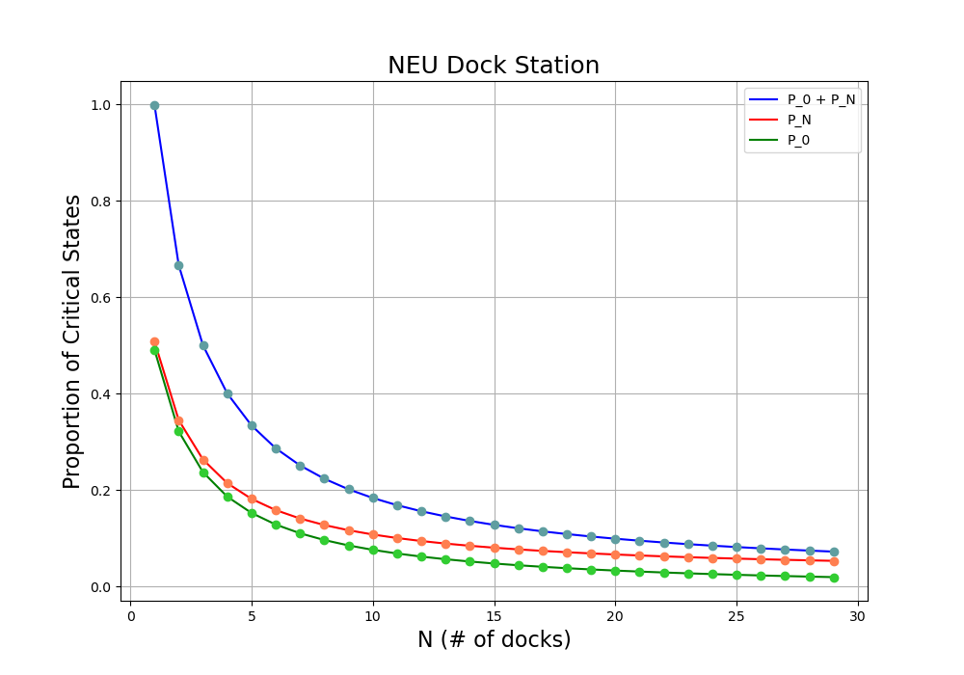







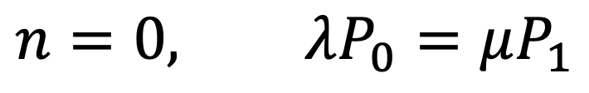



2
Algorithm
$$λ$$
$$λ$$
$$λ$$
$$λ$$
0
1
2
N
$$μ$$
$$μ$$
$$μ$$
$$μ$$
$$n=0, λP_{0}=μP_{1}$$
$$1≤n≤N−1, \left(λ+μ\right)P_{n}=λP_{n−1}+μP_{n+1}$$
$$n=N, {μP}_{N}=λP_{N−1}$$
$$P_{n}=\frac{ρ^{n}\left(1−ρ\right)}{1−ρ^{N+1}} \left(n=0, 1, 2, …, N, ρ=\frac{λ}{μ}\right)$$
Problem
Statement
1
9
3
Criteria
Data Collection
2
Two States of Interest:
State 0 : No available bike at a dock station, which means users cannot borrow bikes when they have demands
State N : All docks are occupied at a dock station, which means users are unable to return their bikes and end their trips.
Assumption
3
4
Data
Process
Target:
Decrease the time proportion of the system in state 0 and state N, expressed mathematically as:
$$\min\left(P_{0}+P_{N}\right)=\min\left[\frac{\left(1−ρ\right)\left(ρ^{N}+1\right)}{1−ρ^{N+1}}\right]$$
5
Model &
Validation
6
Conclusion
Northeastern University | 2024
4
Results
N | Proportion | Diff
12 | 15.59%
13 | 14.51% | 1.08%
14 | 13.58% | 0.93%
15 | 12.77% | 0.81%
16 | 12.05% | 0.72%
17 | 11.42% | 0.63%
18 | 10.85% | 0.57%

Slide 14

3
Criteria
Two States of Interest:
State 0 : No available bike at a dock station, which means users cannot borrow bikes when they have demands
State N : All docks are occupied at a dock station, which means users are unable to return their bikes and end their trips.
Target:
Decrease the time proportion of the system in state 0 and state N, expressed mathematically as:
$$\min\left(P_{0}+P_{N}\right)=\min\left[\frac{\left(1−ρ\right)\left(ρ^{N}+1\right)}{1−ρ^{N+1}}\right]$$
Problem
Statement
1
10
4
Results
Data Collection
2
N | Proportion | Diff
12 | 15.59%
13 | 14.51% | 1.08%
14 | 13.58% | 0.93%
15 | 12.77% | 0.81%
16 | 12.05% | 0.72%
17 | 11.42% | 0.63%
18 | 10.85% | 0.57%
Assumption
3
4
Data
Process
5
Model &
Validation
6
Conclusion
Northeastern University | 2024

Slide 15
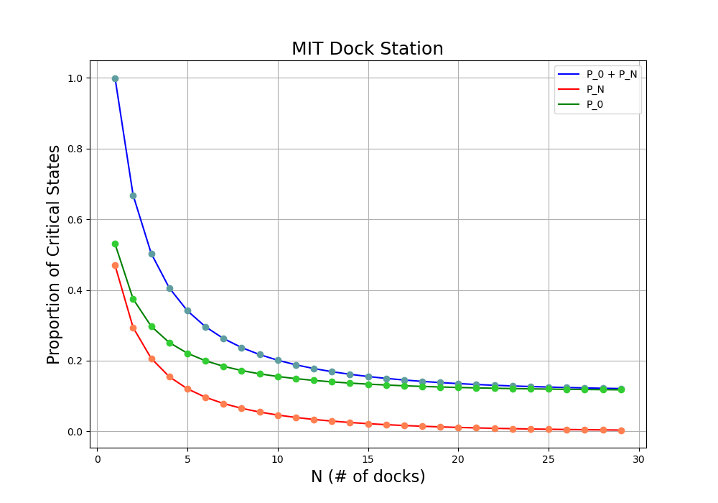
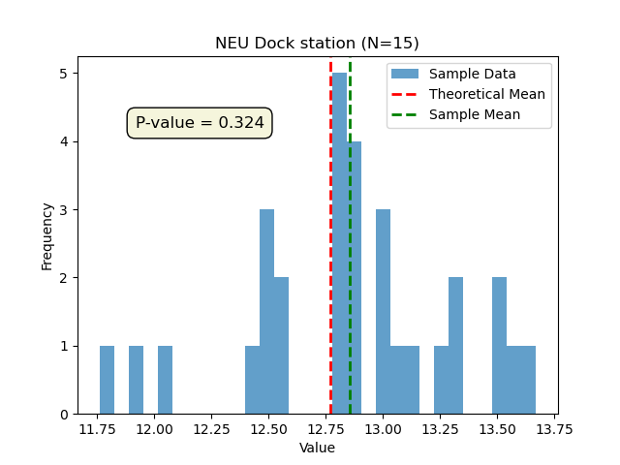
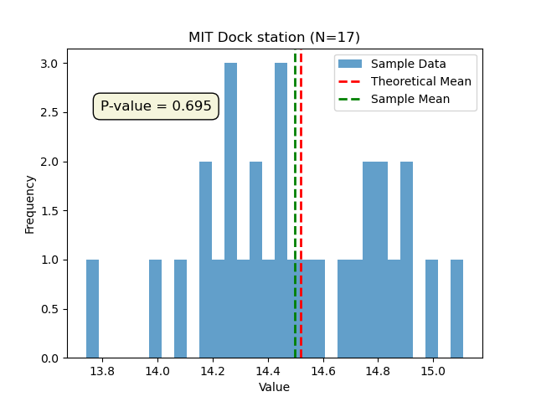
Problem
Statement
1
11
4
Results
Data Collection
2
N | Proportion | Diff
14 | 16.13%
15 | 15.51% | 0.62%
16 | 14.97% | 0.54%
17 | 14.52% | 0.45%
18 | 14.13% | 0.39%
19 | 13.79% | 0.34%
20 | 13.50% | 0.29%
Assumption
3
4
Data
Process
5
Model &
Validation
6
Conclusion
Northeastern University | 2024
5
Verification
Use the Simpy package to simulate this process with a runtime of 100,000 minutes. Run the simulation 30 times and collect the proportion of time spent in state 0 and state N.
Use the one-sample t-test method to compare the sample mean with the theoretical value and check if there is a significant difference between them.

Slide 16
4
Results
N | Proportion | Diff
14 | 16.13%
15 | 15.51% | 0.62%
16 | 14.97% | 0.54%
17 | 14.52% | 0.45%
18 | 14.13% | 0.39%
19 | 13.79% | 0.34%
20 | 13.50% | 0.29%
Problem
Statement
1
12
5
Verification
2
Use the Simpy package to simulate this process with a runtime of 100,000 minutes. Run the simulation 30 times and collect the proportion of time spent in state 0 and state N.
Use the one-sample t-test method to compare the sample mean with the theoretical value and check if there is a significant difference between them.
Data Collection
Assumption
3
4
Data
Process
5
Model &
Validation
6
Conclusion
Northeastern University | 2024
Conclusion
1
User Pattern:
NEU : Higher Arrivals. More residential areas around the station lead to higher bike arrivals during peak hours as residents return bikes and head home.
MIT : Higher Departures. Tourist areas along Charles River increases bike departures as users are not only students, but also tourists.

Slide 17
5
Verification
Use the Simpy package to simulate this process with a runtime of 100,000 minutes. Run the simulation 30 times and collect the proportion of time spent in state 0 and state N.
Use the one-sample t-test method to compare the sample mean with the theoretical value and check if there is a significant difference between them.
Problem
Statement
1
13
Conclusion
Data Collection
2
1
User Pattern:
NEU : Higher Arrivals. More residential areas around the station lead to higher bike arrivals during peak hours as residents return bikes and head home.
MIT : Higher Departures. Tourist areas along Charles River increases bike departures as users are not only students, but also tourists.
Assumption
3
4
Data
Process
5
Model &
Validation
6
Conclusion
Northeastern University | 2024

Slide 18
Problem
Statement
1
14
Conclusion
Data Collection
2
2
Station Dynamics on Availability:
NEU : Near by several subway stations, bicycles become an important connection to the subway, resulting in NEU dock station reaching full capacity quickly. Effective bicycle diversion strategies are necessary for peak hours crowd management.
MIT : Due to the lack of subway options in the neighborhood, demand for bicycles increases during peak hours, requiring constant replenishment of bicycles to maintain service efficiency.
Assumption
3
4
Data
Process
5
Model &
Validation
6
Conclusion
Northeastern University | 2024

Slide 19
Problem
Statement
1
15
Data Collection
2
3
Q & A
Assumption
4
Data
Process
5
Model &
Validation
6
Conclusion
Northeastern University | 2024

Slide 20
Northeastern University | 2024
THANK YOU
Presented By : Jinqiao Chen, Ming Luo

